Slide 1

Individual Support Plan
Notes:
Welcome to the pre recorded workshop on Individual Support Plans, provided by Resources of Exceptional Children and Youth – Durham Region

Slide 2

Land Acknowledgement
We are currently located on the land which has long served as a site of meeting and exchange among the Mississauga Peoples and is the traditional and treaty territory of the Mississaugas of Scugog Island First Nation. We honour, recognize and respect this nation and Indigenous Peoples as the traditional stewards of the lands and waters on which we meet today.

Slide 3


Agenda
Purpose of the ISP
ISP function and how it is to be used in the Child Care setting
Who is involved in creating an ISP and how to include them in the development
Clarity on the role of community agencies and educators
Confidently create an ISP in your center

Slide 4
Resource Consultant
Provides consultation to early learning and childcare programs
Supports the early learning and childcare community through capacity building
Provides service navigation and linkage to early learning and childcare programs
Support Early Learning and Child Care Sectors (Licensed Group Child Care, Licensed Home Child Care, and EarlyOn programs) to facilitate learning and inclusion for all children
Notes:
Here is a brief overview of our role before we dive deeper into ISPs. As RC Consultants, we…

Slide 5
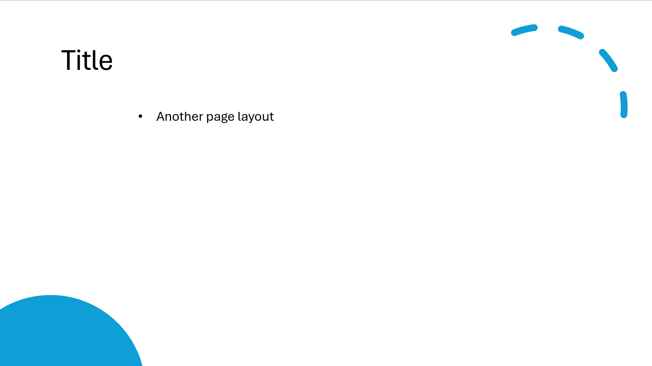

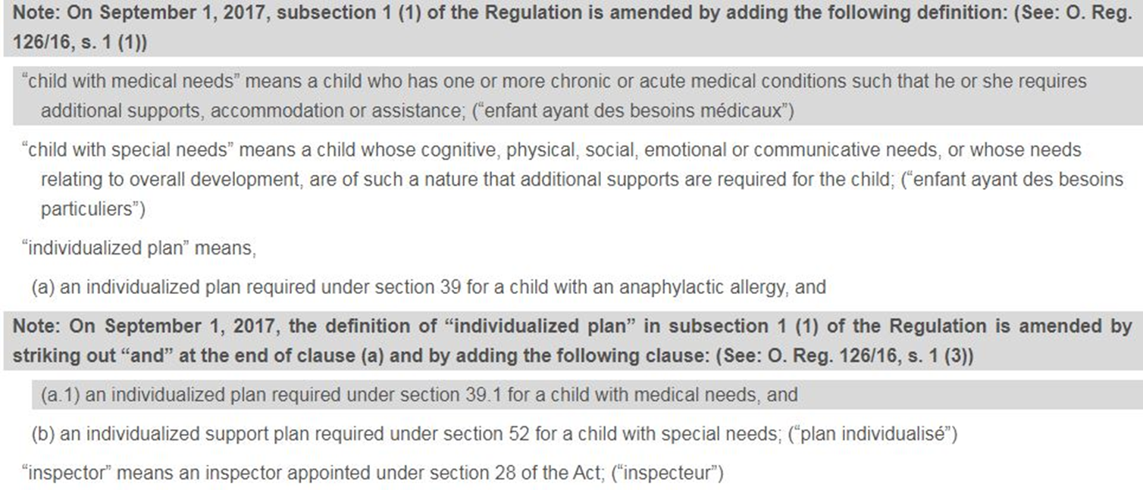
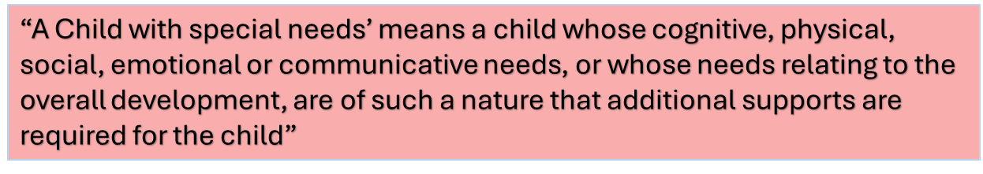
Notes:
In 2017, the Ministry made a change to define “a child with special needs”.
What this means for the Child care community is… Child Care Workers need to be aware that the Ministry is NOT defining special needs by simply a diagnosis, but your needs as a classroom and/or Centre for additional supports. This could mean children who have supports such as braces, walkers, special seating, communication supports or behavioural concerns.

Slide 6
How often should an ISP be reviewed?
The ISP should be reviewed on an ongoing basis
The ISP should be reviewed --- as the child’s abilities, needs, classroom and circumstances change
The ISP ---and should be reviewed by parents, staff, volunteers, community partners, and students involved with the child care center
Notes:
-According to the Act – the minimum requirement to review and/or update a ISP is 1 year.
Best practice, what we as RC’s are suggesting is 6 months and/or when child moves room
This will ensure that the centre goals is still appropriate, still works for the child, and provided the opportunity to change if goals are met.

Slide 7

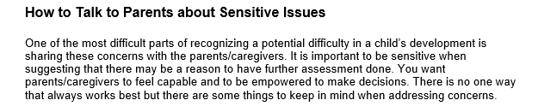
Connecting with Family
Notes:
As early learning professionals, we have An amazing opportunity and privilege to build relationships and communicate with the families and guardians on a regular basis. These conversations can be focused on amazing updates such as their child's development, the peer relationships they are developing and the learning happening within their spaces.
Sometimes though the conversations we have with families are a little more difficult and require a little more planning when navigating them. These conversations can be around topics such as developmental concerns, red flags and perhaps brining up the conversation of developing an isp.
Build up to the conversation, share your observations with families in an objective and supportive way. Ask for their expertise and work on strategies together. This way it will be less of an abrupt conversation, it will not be a surprise. Focus on collaboration and partnership.

Slide 8

What other Services is the Family Accessing?
Review their childcare application.
Ask the family to share who is involved with them.
Offer to connect them with services by having the family sign a two-way consent form.
Offer to arrange a team meeting with all services involved.
Notes:
When meeting with the early learning communities, we often ask these questions to build their capacity with creating family rapport. Here is where we, as supports, can direct the educators to find this information. We also like to point out that these questions may be an opportunity to ask during the tough conversations educators may have with parents.

Slide 9
Who May Collaborate on a Child’s ISP
Resources for Exceptional Children and Youth – Durham Region
Grandview Kids
Children’s Developmental Behavioral Supports
Kerry’s Place Autism Services
Kinark Child and Family Services
Down Syndrome Association
Holland Bloorview Children Centre
Geneva Centre for Autism
Autism Ontario
School Boards
Notes:
Here are a few agencies and supports that may help you through the ISP process.
School Boards may be involved if the child is 4 and above, and have an IEP in school.

Slide 10
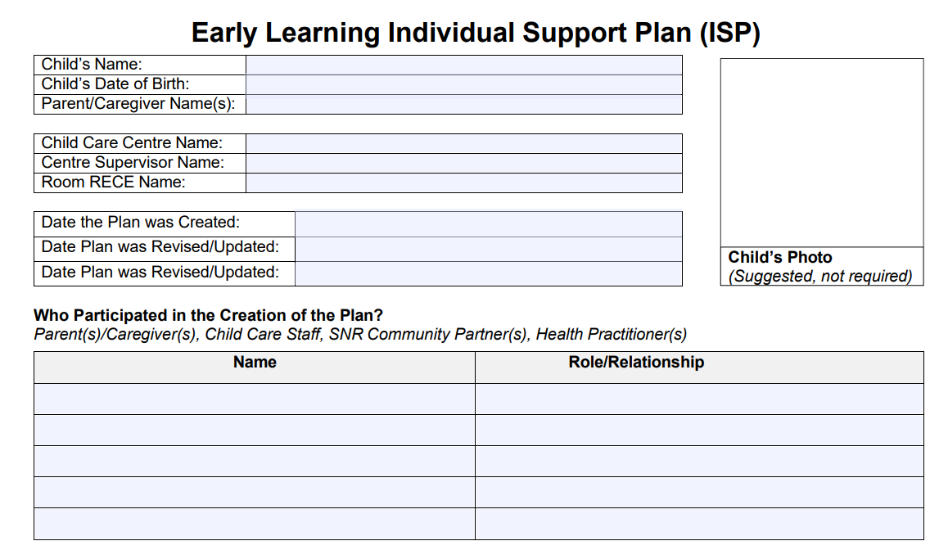
87%
Details
about statistic cited right
Notes:
Now I am going to go through each page of our new ISP template.
We wanted to make the document as easy and accessible as possible.
On the first page of the ISP is all about the child’s information (name, DOB, caregivers) and who helped create the ISP.
There is an option to add a photo of the child, to support a better understanding for any new staff entering the center. It can become quite confusing to remember names and ISP’s within the first few weeks!
The ISP is a document meant to be kept in a file, and not posted anywhere visible in the classroom.

Slide 11
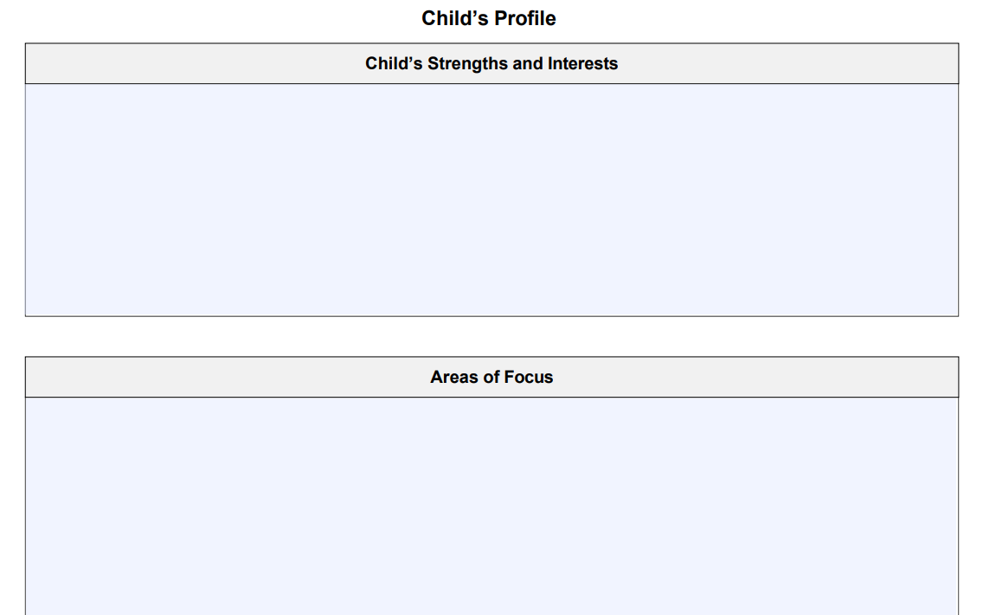
87%
Details
about statistic cited right
Notes:
The second page of the ISP is where Educators and Parents or Outside Agencies can collaborate and discuss the child’s strengths, as well as areas of focus.
This part of the ISP really supports the relationship between the center and the parents/guardians, as it starts off discussing any strengths and interests of the child. It will allow the parents/guardians to feel more involved with the ISP process, while discussing the positives everyone notices in their child.
The “Area of Focus” box is more geared towards goals the child care center wants to work on. It is important to note that this area is child care focused, meaning the goals written in this box will be goals completed within the child care setting.
Any external partners such as Grandview or Children’s Developmental Behavioral Supports may have separate goals, but anything on the ISP are directly related to goals within the child care.

Slide 12
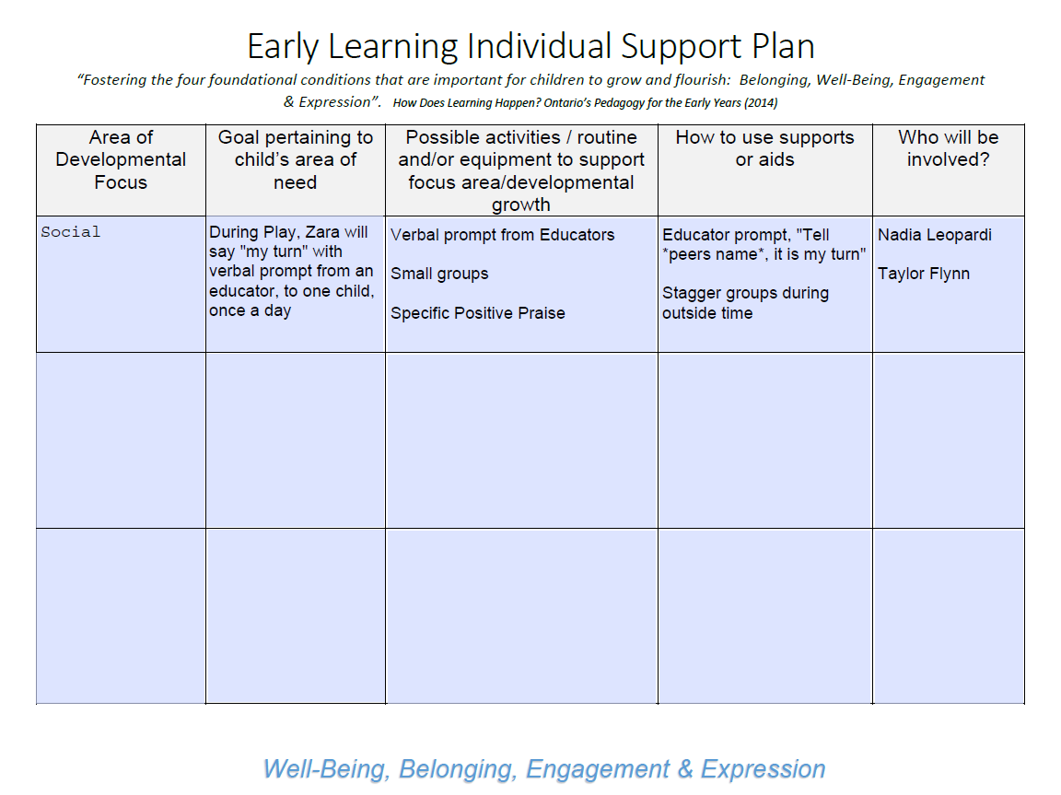
Details
about statistic cited right
Notes:
The third page of the ISP is where we discuss the goals for the child and how we can best accommodate them to complete these goals.
The first collum is where we would put the developmental domain in which the goal obtains to such as social, emotional, physical or cognitive
In the second collum is what the specific goal is for the child.
The third collum is what activities, routines or equipment is needed to support this goal
Forth Collum is how the goal will be implemented
And last collum would be who is involved to support this goal
Above you can see a example of a goal.
In the example above we can see that the developmental domain of this specific goal is social.
In the next collum it shows the specific goal is “ read” its important to be a specific as possible as the goal will change as the child achieves this goal. For example, in a month this goal may increase from one child once a day to two children twice a day.
The next collum what we as eductors will be doing to support this goal. In this example we will be “read”
The next collum is how educators will implement the goal. In this example “read”
And the last collum is who is involved. This is where you would add educators names, family or who will be doing this daily with the child. In this example it would be the two classroom educators.

Slide 13
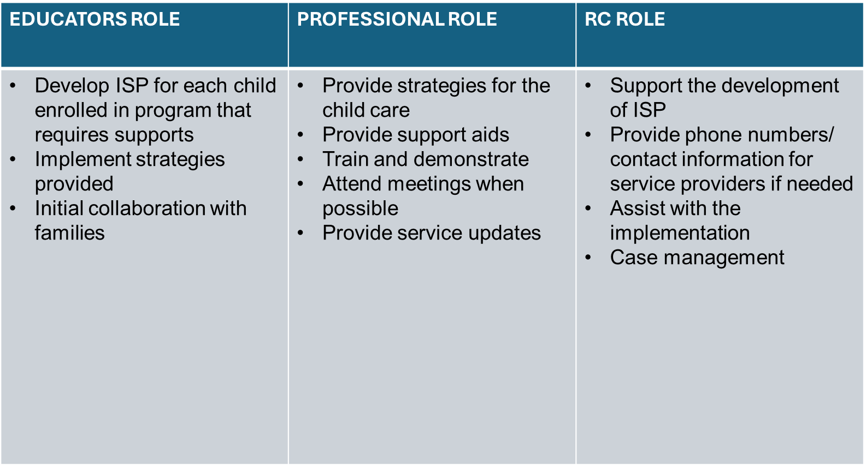
Who Does What?
Notes:
Now that we’ve gone through how to create an ISP with you, we thought it was important to discuss everyone’s roles involved.

Slide 14




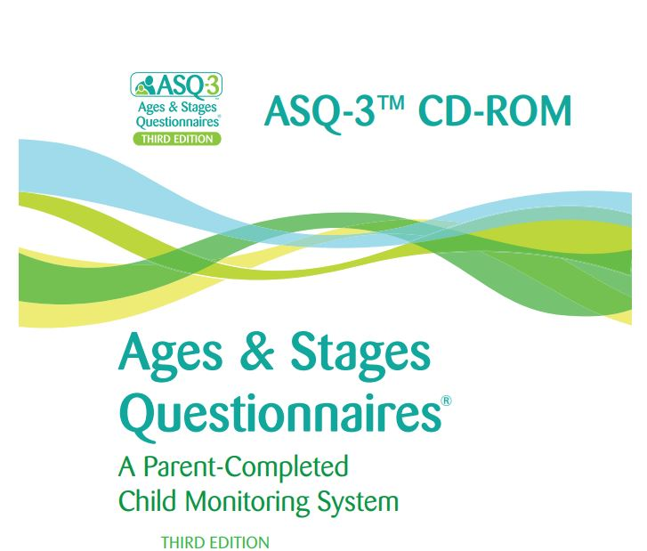

Tools to Gather Information
Notes:
Here are some resources that RC’s are suggesting child cares use to determine if the room is set up as an inclusive space, or any red flags the Educators may have. The Nipissing Checklist or Looksee chicklist would also come in handy, to present any concerns regarding the child’s development throughout the ISP process.

Slide 15
How to Access Our Template
Need help with | Contact
Electronic Copies of ISP Samples | http://www.rfecydurham.com/resourceportal/child-care/individualized-support-plan
Individual Support Plan Implementation | Contact your RC Consultant or RFECY 905-427-8862
Connecting with Community Partners | No Wrong Door Binder
Notes:
If you are wanting to use our ISP template, you can get it directly from our website or You can also connect with your RC Consultant, and we will be more than happy to help you through the process.
If your agency has their own template and that is completely fine. Your Resource Consultant can still support you with the creation of an ISP.

Slide 16

Thank you!
Notes:
Thank you so much for participating in our presentation! We hope you have gained some knowledge around ISPs, and feel confident creating one in your classroom.
Again, if you have any questions about anything discussed today, please do not hesitate to connect with your RC Consultant.

